Slide 1
Humidity and Temperature (DHT11) Sensor
Prepared by Suk Jin Lee
Notes:
https://www.youtube.com/watch?v=nssXWNYdGT8
https://www.youtube.com/watch?v=OogldLc9uYc
https://www.youtube.com/watch?v=nssXWNYdGT8
Using LCD Displays with Arduino
https://www.youtube.com/watch?v=wEbGhYjn4QI

Slide 2
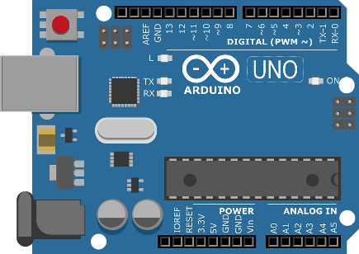
Arduino Boards
What is Arduino?
Arduino is an open-source electronics platform based on easy-to-use hardware and software. Arduino boards are able to read inputs and turn it into an output.
USB

Slide 3
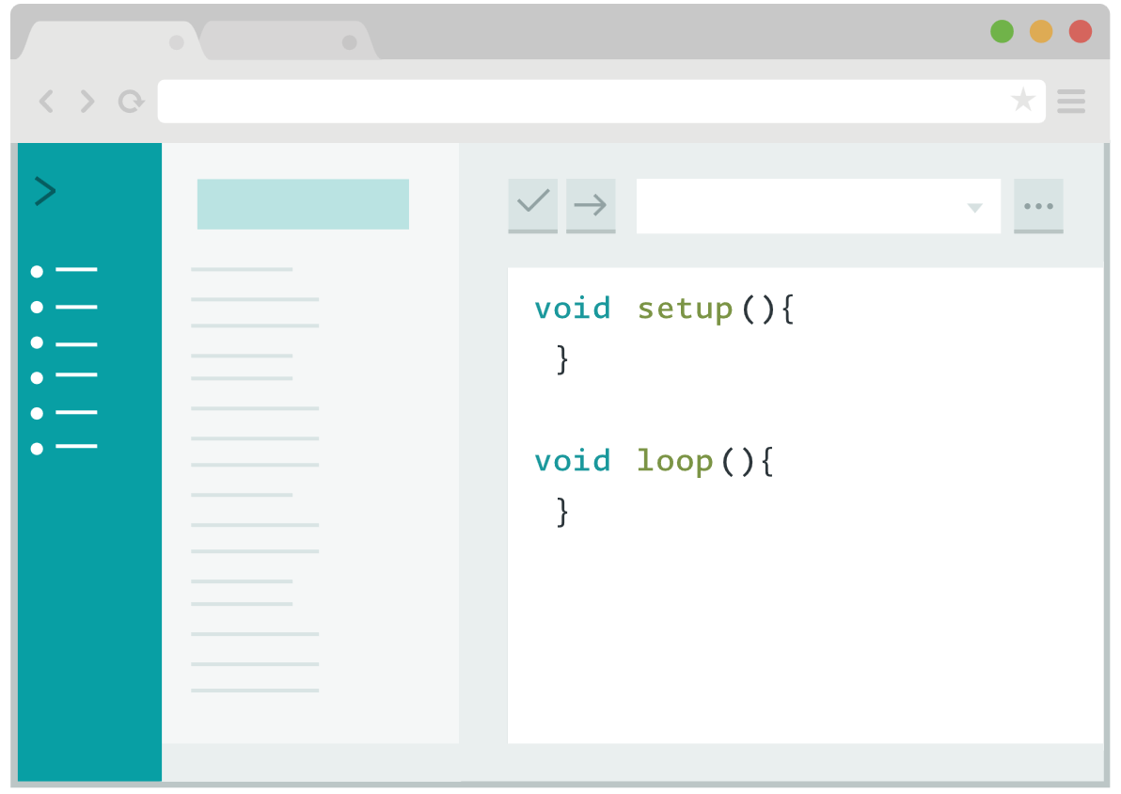
Arduino Software
You can tell your Arduino what to do by writing code in the Arduino programming language and using the Arduino development environment.
Notes:
https://www.arduino.cc/en/software

Slide 4
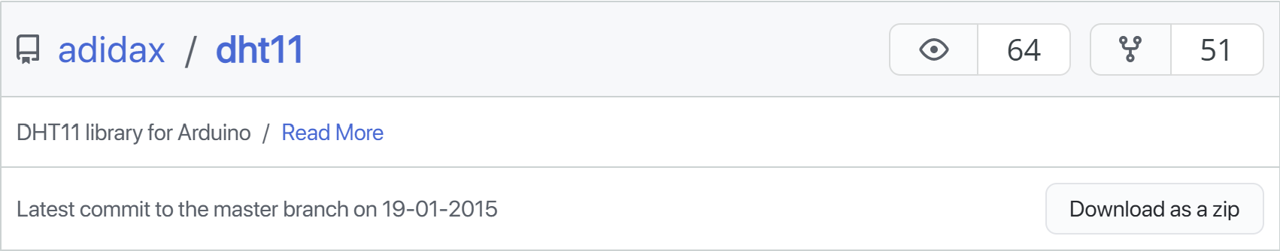
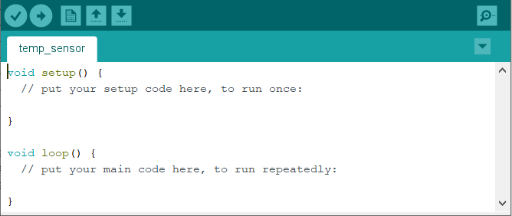
Install the DHTLib library
Go to DHTLib and download the DHTLib.zip file.
Open Arduino IDE
Sketch > Include Library > Add .ZIP Library and select the DHTLib.zip (adidax-dht11-b7fbbcd.zip) file.
Save the file as “temp_sensor”.
Notes:
https://projecthub.arduino.cc/arcaegecengiz/using-dht11-12f621
http://www.circuitbasics.com/how-to-set-up-the-dht11-humidity-sensor-on-an-arduino/

Slide 5

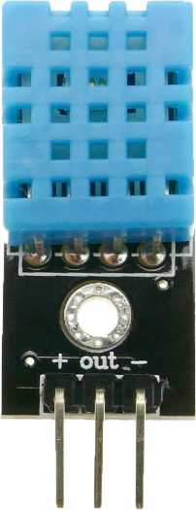
Designing the hardware prototype
Wiring the DHT11 to the Arduino
① GND to (−)
GND
Pin 4
③ Pin 4 to out
+
−
out
② +5V to (+)
+5V
Note: Your pin order may be different from the figure. Faulty Wiring can Lead to Fire Hazards and/or destructive impact on the sensor~!

Slide 6
Designing the hardware prototype
Wire configuration
Arduino | DHT11 sensor
Pin 4 | out (Data)
5v | + (VCC)
GND | − (GND)

Slide 7
Software
#include <dht11.h>
#define DHT11_PIN 4
dht11 DHT11;
void setup(){
Serial.begin(9600);
delay(500); //delay to let system boot
Serial.println("DHT11 Humidity & temperature sensor\n\n");
delay(1000); // wait before accessing sensor
}
void loop()
{
int chk = DHT11.read(DHT11_PIN);
Serial.print("Temperature = ");
Serial.print(DHT11.temperature);
Serial.println("C ");
Serial.print("Humidity = ");
Serial.print(DHT11.humidity);
Serial.println("% ");
delay(5000); // wait 5 seconds before accessing sensor again
}

Slide 8
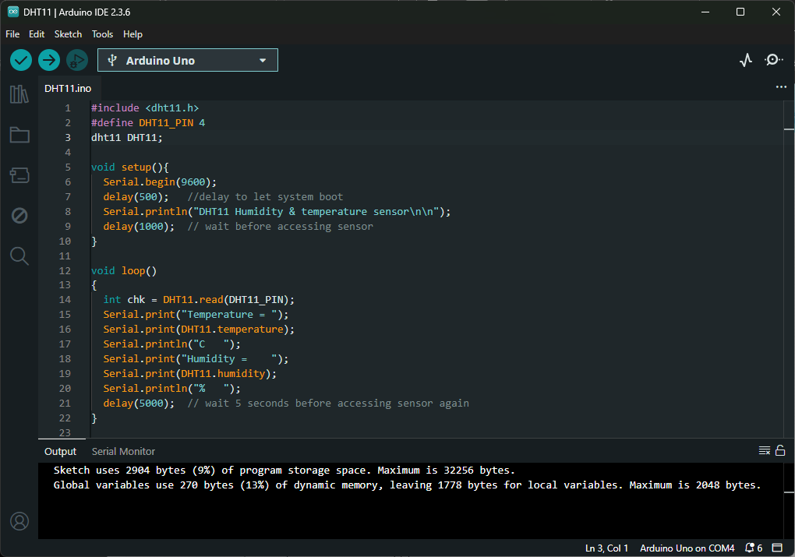

Slide 9
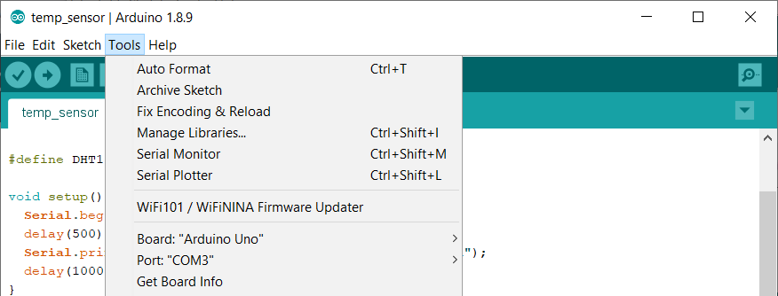
Execute
Make sure that you have a correct board and port number:
Board: “Arduino Uno”
Port: “COM3” (depend on your system)
Verify and Upload.

Slide 10
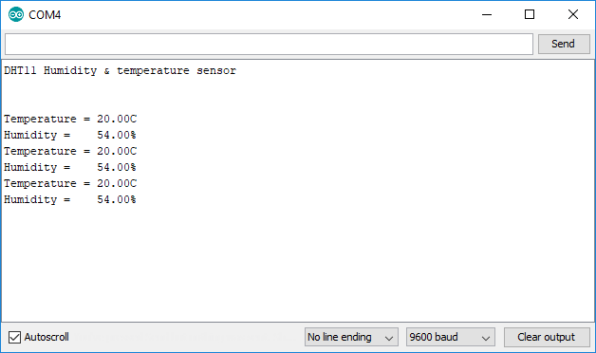
Serial Monitor
Tools > Serial Monitor

Slide 11
Exercise
Convert Celsius to Fahrenheit
F = C * 9/5 + 32
Notes:
https://www.rapidtables.com/convert/temperature/celsius-to-fahrenheit.html

Slide 12
HC-SR501 Body Sensor Module
Notes:
https://www.amazon.com/HC-SR501-Sensor-Infrared-Arduino-Raspberry/dp/B07KBWVJMP/ref=asc_df_B07KBWVJMP/?tag=hyprod-20&linkCode=df0&hvadid=385487162049&hvpos=&hvnetw=g&hvrand=14008606044634163212&hvpone=&hvptwo=&hvqmt=&hvdev=c&hvdvcmdl=&hvlocint=&hvlocphy=9011443&hvtargid=pla-823732620719&psc=1&tag=&ref=&adgrpid=79288771155&hvpone=&hvptwo=&hvadid=385487162049&hvpos=&hvnetw=g&hvrand=14008606044634163212&hvqmt=&hvdev=c&hvdvcmdl=&hvlocint=&hvlocphy=9011443&hvtargid=pla-823732620719

Slide 13
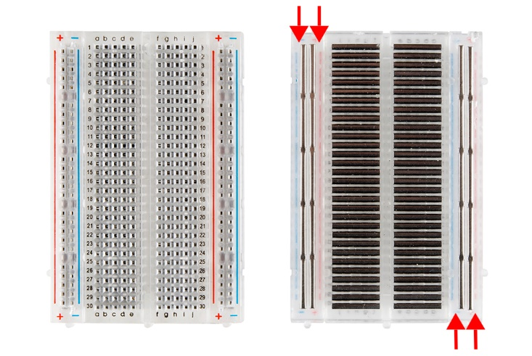
How to Use a Breadboard
Breadboard
wires
All holes in each row are connected
All holes in this column are connected
wires

Slide 14

LED (Light-emitting Diode)
LED
The positive side (+) is called the anode
The negative one (−) is called the cathode
+
−
+
Symbol:
−
https://en.wikipedia.org/wiki/Light-emitting_diode

Slide 15
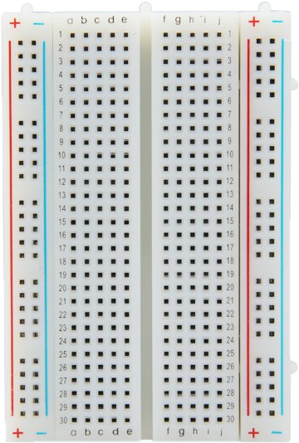
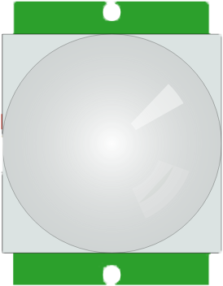
Schematics (1)
Wiring PIR Sensor to the Arduino
GND
LED
②
③
−
+
②
⑤
④
①
VCC
Out
PIR Sensor
②
GND
①
+5V
Note: Your pin order may be different from the figure. Faulty Wiring can Lead to Fire Hazards and/or destructive impact on the sensor~!
Notes:
https://create.arduino.cc/projecthub/55845/innovation-lab-11-pir-motion-sensor-with-led-43420e

Slide 16
Schematics (2)
Wire configuration
Arduino | PIR Sensor | LED | Resister
+5v | VCC
GND | GND | Negative (−; short leg)
Pin 2 | Out (Data)
Pin 7 |  |  | One end
 |  | Positive (+; long leg) | Another end

Slide 17
Software
PIR (Motion Sensor) LED turn on or turn off
int LED = 7;
int PIR = 2;
void setup() {
pinMode(LED, OUTPUT);
pinMode(PIR, INPUT);
Serial.begin(9600);
}
void loop() {
int PIR_val = digitalRead(PIR);
Serial.println(PIR_val);
if (PIR_val == HIGH) {
digitalWrite(LED, HIGH);
Serial.println("Motion detected");
}
else {
digitalWrite(LED, LOW);
Serial.println("Motion not detected");
}
}

Slide 18
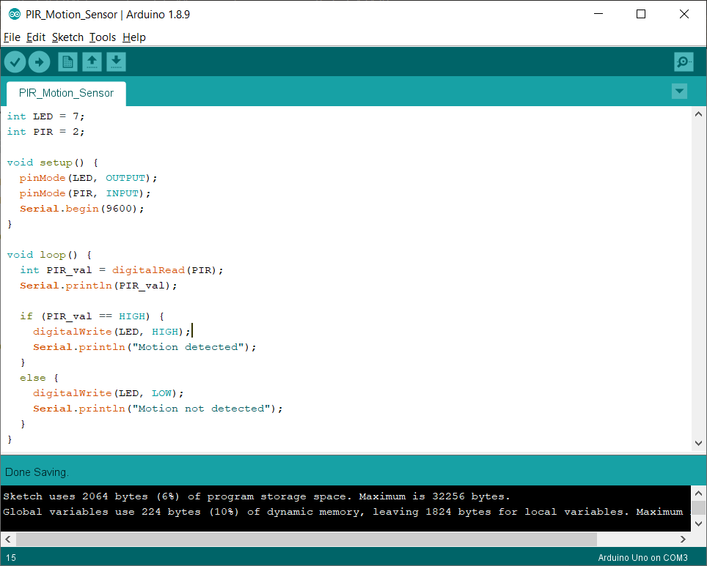

Slide 19
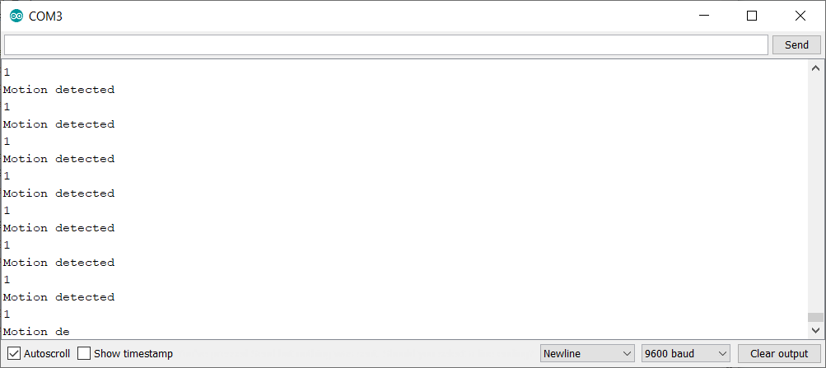
Serial Monitor
Tools > Serial Monitor
Check the status of LED.

