Slide 1
ArduCAM Mini 2MP with ESP8266 NodeMCU
Prepared by Suk Jin Lee

Slide 2
What is ArduCAM
ArduCAM is an open-source project for Arduino camera since back to 2012.
It is the world’s first serial peripheral interface (SPI) camera for Arduino and fills the gap of missing camera support in Arduino ecosystem.

Slide 3
NodeMCU ESP8266
ESP8266 Wi-Fi transceiver module
An open-source firmware and development kit that helps you to prototype or build IoT products.
Compatible with the 802.11 b/g/n standard at 2.4 GHz
Cost-effective IoT Solution with Arduino
Arduino is widely used cost-effective open-source development platform for embedded and IoT applications.
Arduino IDE is extremely friendly to all users, including the new starters.

Slide 4
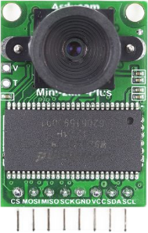

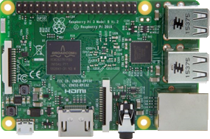
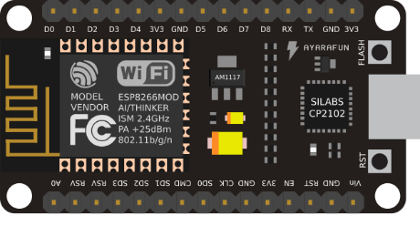
Microcontroller to Raspberry Pi (1)
Microcontroller to Raspberry Pi Wi-Fi Communication
Stream Server
(ArduCAM mini 2MP)
Access Point
(Raspberry Pi)
http protocol
Local Network
ESP8266 Wi-Fi
ArduCAM mini 2MP with ESP8266 nodeMCU
USB
Desktop/Laptop

Slide 5
Microcontroller to Raspberry Pi (2)
Microcontroller to Raspberry Pi Wi-Fi Communication
Stream Server
(ArduCAM mini 2MP)
Access Point
(Raspberry Pi)
Stream Server
(IP: 192.168.4.6)
Dynamic (dhcp)
SSID, PASSWORD
Access Point
(wlan0: 192.168.4.1)
static
Wi-Fi Mode = Station Mode(0) or Access Point Mode (1)

Slide 6
NodeMCU to ArduCAM Mini 2MP
Wiring between NodeMCU and ArduCAM Mini 2MP
ArduCAM Mini 2MP | ESP8266 NodeMCU
CS | D0
MOSI | D7
MISO | D6
SCK | D5
GND | GND
VCC | 3V3
SDA | D2
SCL | D1
Be careful. Faulty Wiring can Lead to Fire Hazards~!
Notes:
https://forum.arducam.com/t/some-questions-about-arducam-mini-2mp-plus-with-nodemcu-v3/1011/3

Slide 7
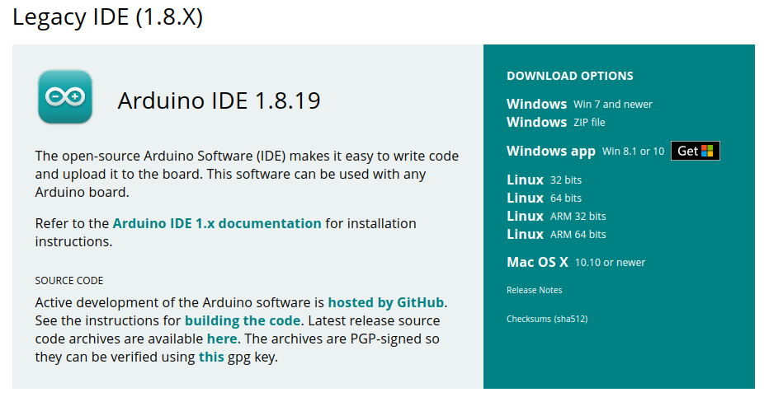
Installation Instructions (1)
Install the current upstream Arduino IDE at the 1.8 level or later.
Notes:
Run the Install Script: https://docs.arduino.cc/software/ide-v1/tutorials/Linux/

Slide 8
Installation Instructions (2)
Install Arduino IDE using APT Manager
sudo apt update
sudo apt install arduino
sudo arduino
Start Arduino
Open Preferences window and include additional Boards Manager URLs:
http://www.arducam.com/downloads/ESP8266_UNO/package_ArduCAM_index.json
https://dl.espressif.com/dl/package_esp32_index.json
http://arduino.esp8266.com/stable/package_esp8266com_index.json

Slide 9
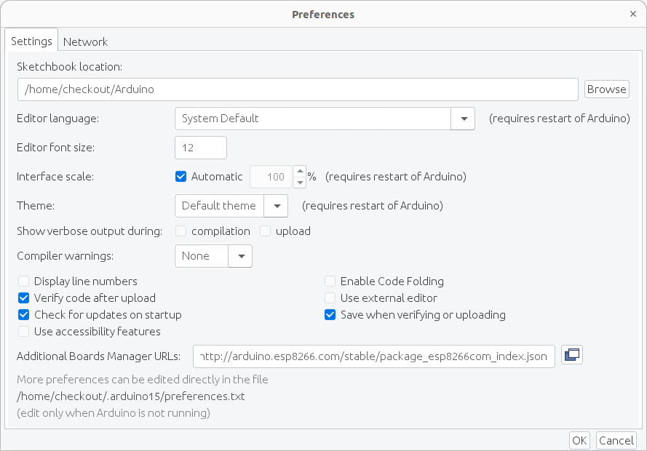

Slide 10
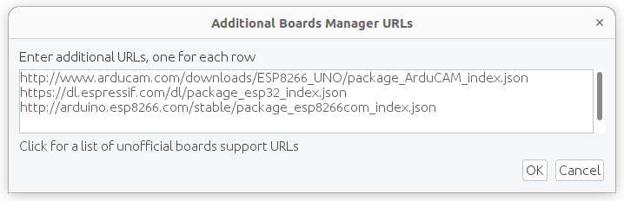

Slide 11
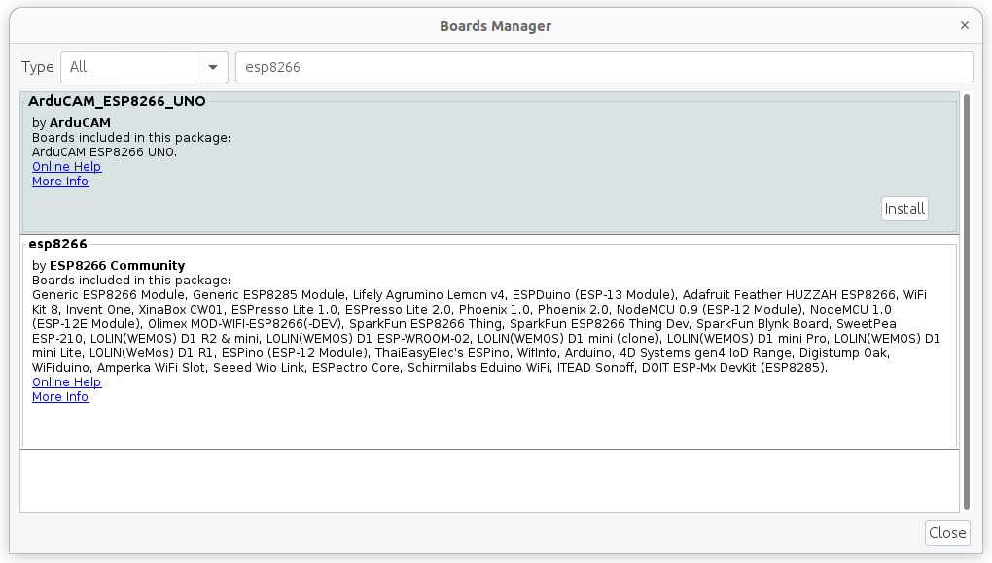
Installation Instructions (3)
Open Boards Manager from Tools > Board menu and install esp8266 platform

Slide 12
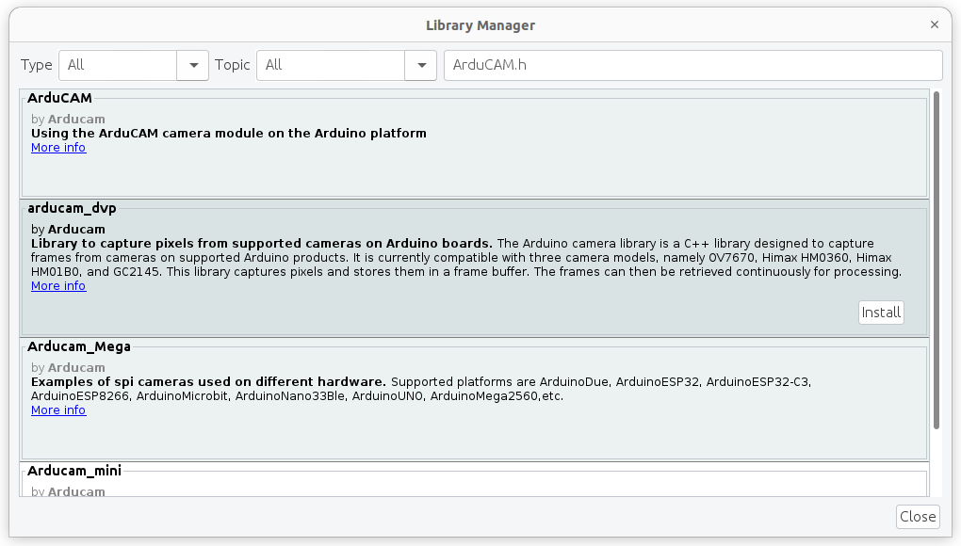
Installation Instructions (4)
Open Manage Libraries: Sketch > Include Library > Manage Libraries and install ArduCAM

Slide 13
Quickly Run the Demo (1)
ArduCAM_ESP8266_UNO.ino
https://www.arducam.com/arducam-supports-esp8266-arduino-board-wifi-websocket-camera-demo/

Slide 14
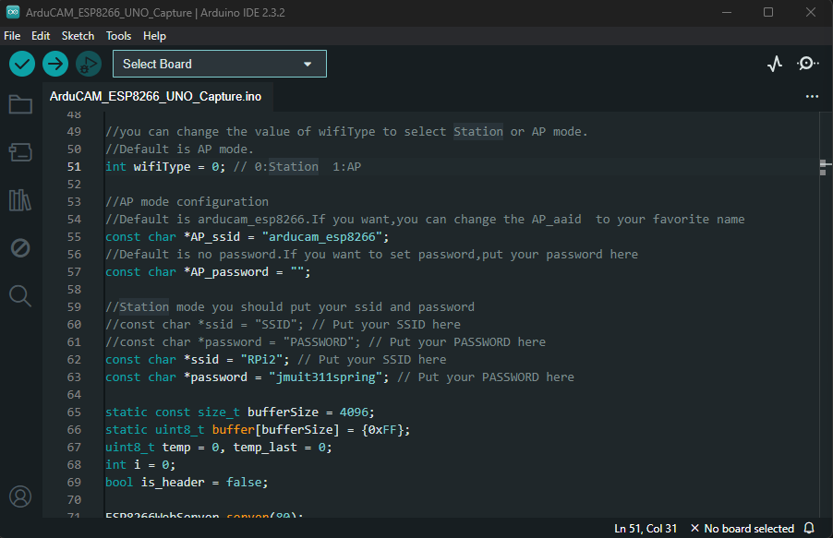
Quickly Run the Demo (2)
Set “SSID” and “PASSWORD.”
Set Wi-Fi Mode: wifi_mode = 0 (station mode)

Slide 15
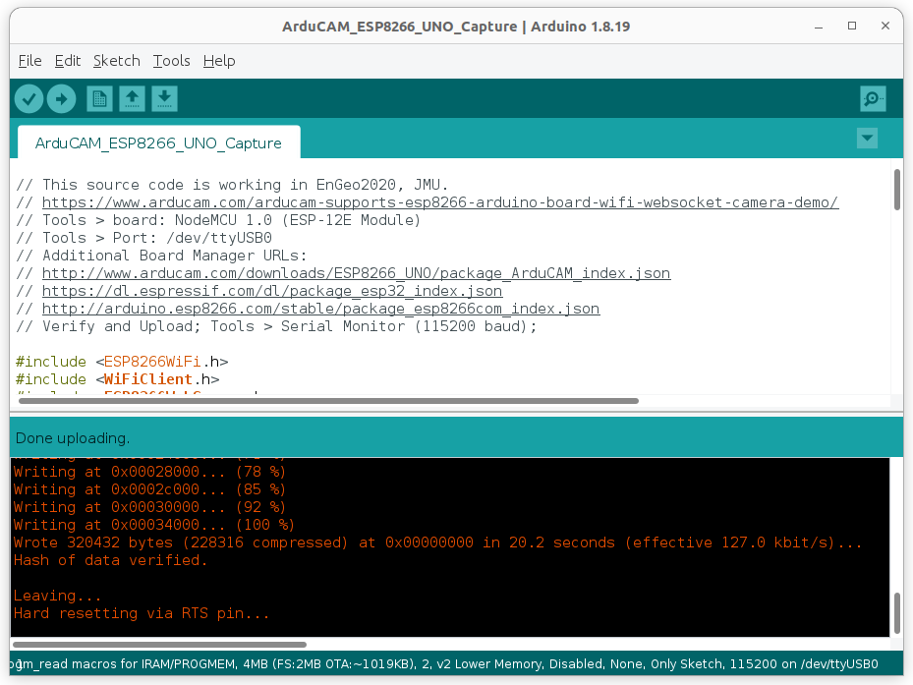
Quickly Run the Demo (3)
Select a board:
Tools >Board > ESP8266 Boards > NodeMCU 1.0 (ESP-12E Module)
Click “Verify” and “Upload.”

Slide 16
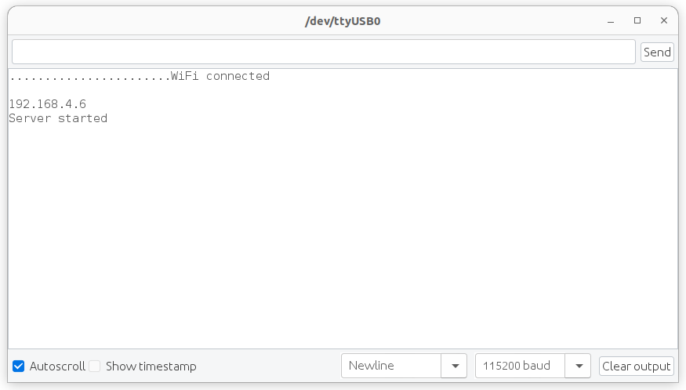
Serial Monitor
After compiling and uploading the file, you can check the status using the serial monitor.
Set baud rate: 115200 baud
Make sure that your nodeMCU connected to RPi and the server started (e.g., IP: 192.168.4.6).
Streaming server IP

Slide 17
Access to the Server (1)
Click “web Browser” in your raspberry pi.
Type the IP of Stream Server: 192.168.4.6/stream
The capture and streaming features can be reached directly via the browser by using the format:
For still capture: http://IPaddress/capture
For streaming video: http://IPaddress/stream

Slide 18

Access to the Server (2)
Click “web Browser” from your smartphone.
Type the IP of Stream Server: 192.168.4.6/stream

