Slide 1
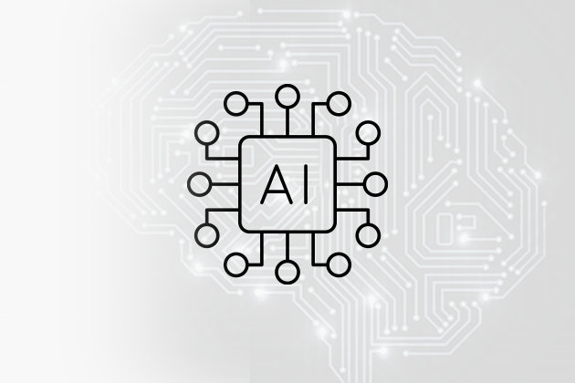
AI IMAGE CLASSIFICATION · FINAL SHOWCASE · JUNE 12, 2026
[Your Team Name Here]
[One catchy line: what does your AI do?]
[Teammate 1] · [Teammate 2] · [Teammate 3]

Slide 2
Our model
What does our AI classify?
Picture of your animals
List your animal classes here.
Example: deer · fox · squirrel · raccoon
(Delete the gray hints on every slide and replace with your own words!)
Drop in 1–2 fun sample photos from your dataset.
Insert → Image
Who would use it, and for what?
Example: hikers who want their trail camera to text them when a bear walks by.

Slide 3
How we built it — and how it scored
The build, in your own words
Your charts
Example: we used transfer learning — borrowed MobileNetV2 (trained on 1.4M photos) and trained our own decision layer on top.
Paste from your notebook:
• the training curve (accuracy per epoch)
• the confusion matrix
Both were saved as PNG files by the team notebook — download them from the Colab file panel.
FINAL VALIDATION ACCURACY
[ 00% ]
v1 scored [00%] → after improvements: [00%]

Slide 4
Issues 🔍
1 · The mistake
2 · Our theory
3 · The fix
Show 1–2 photos your model got WRONG (from your mistake gallery).
Example: it kept calling foxes 'squirrels'.
WHY did it fail?
Example: both are orange-brown with bushy tails, and most of our fox photos were far away.
What did you change, and what happened to accuracy?
Example: added 40 close-up fox photos → fox accuracy 61% → 88%.

Slide 5
Results
Success
What we learned
Screenshots of it working.
One sentence per teammate — technical or not!
Example: 'Data quality matters more than fancy code.'
Thank you! Questions?

